Slide 1
Chapter 5
JavaScript and
XHTML Documents
Programming the World Wide Web
Fourth edition
By Robert W. Sebesta

Slide 2
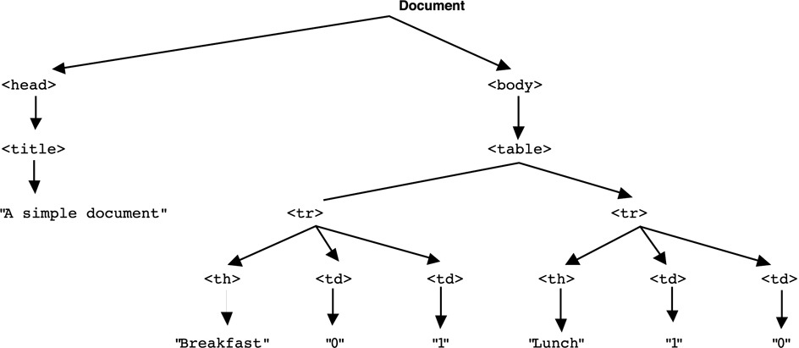
Figure 5.1 The DOM structure for a simple document

Slide 3
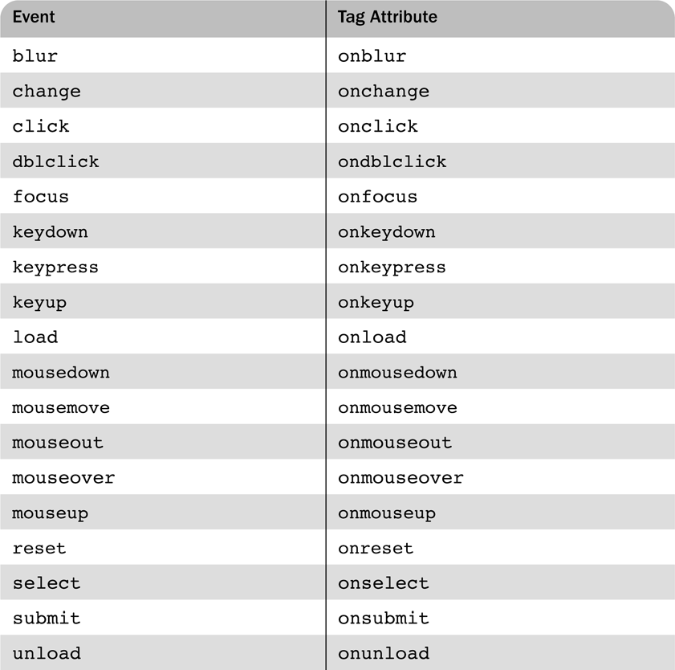
Table 5.1 Events and their tag attributes

Slide 4
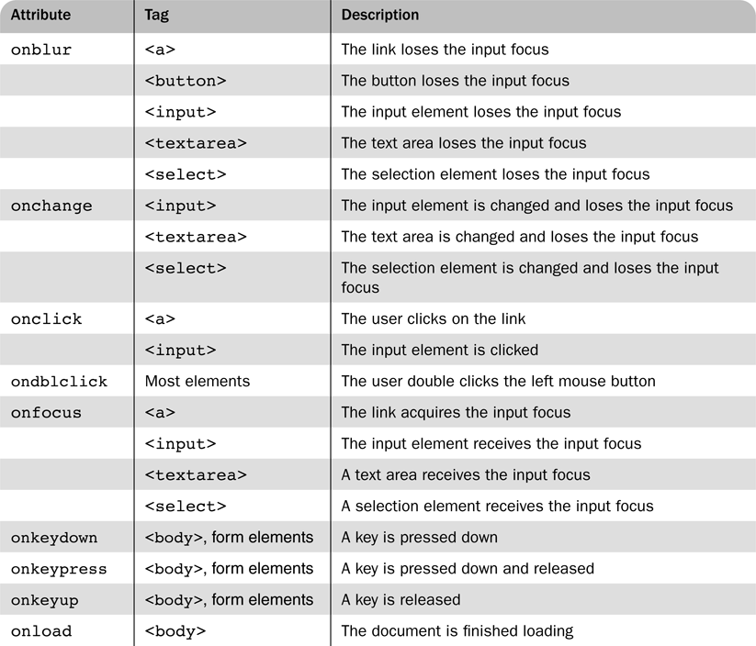
Table 5.2 Event attributes and their tags

Slide 5
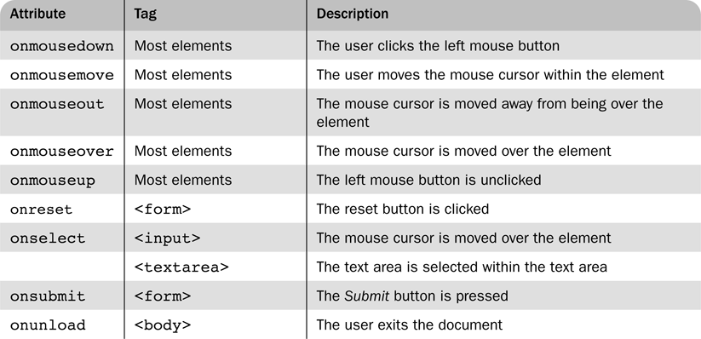
Table 5.2 Event attributes and their tags (cont)

Slide 6
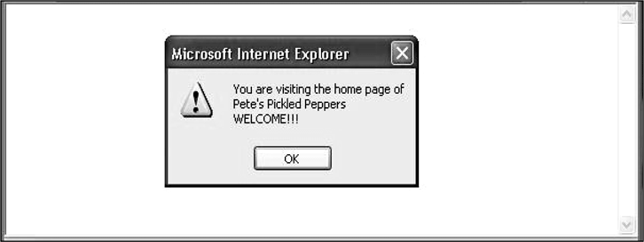
Figure 5.2 Display of load.html

Slide 7
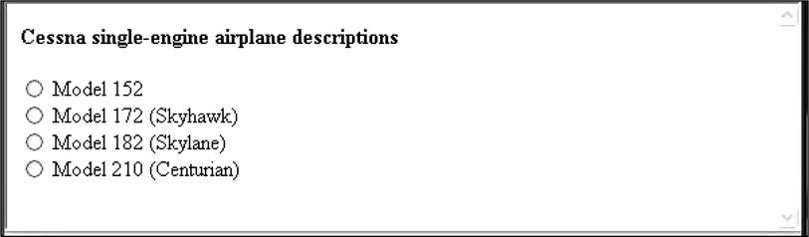
Figure 5.3 Display of radio_click.html

Slide 8
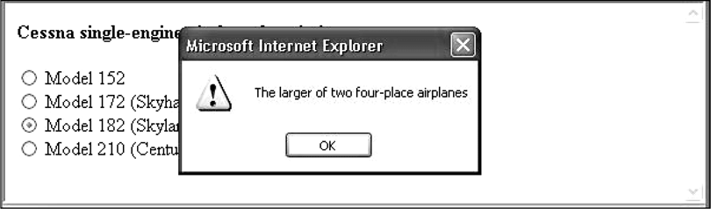
Figure 5.4 The result of pressing the Model 182 button in radio_click

Slide 9
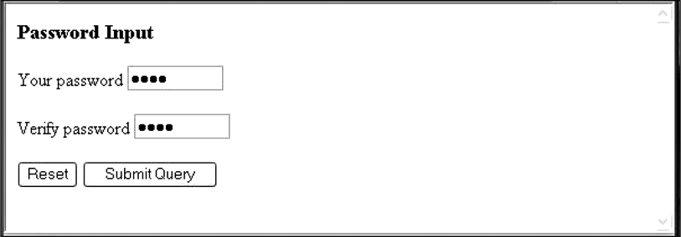
Figure 5.5 Display of pswd_chk.html after it has been filled out

Slide 10
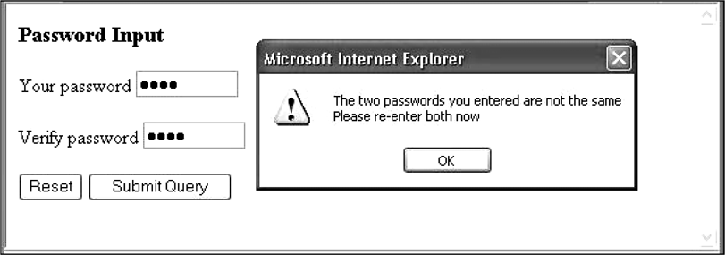
Figure 5.6 Display of pswd_chk.html after Submit Query has been clicked

Slide 11
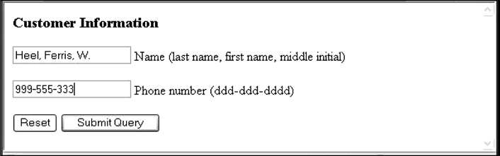
Figure 5.7 Display of validator.html, with an invalid phone number, while the phone text field has focus

Slide 12
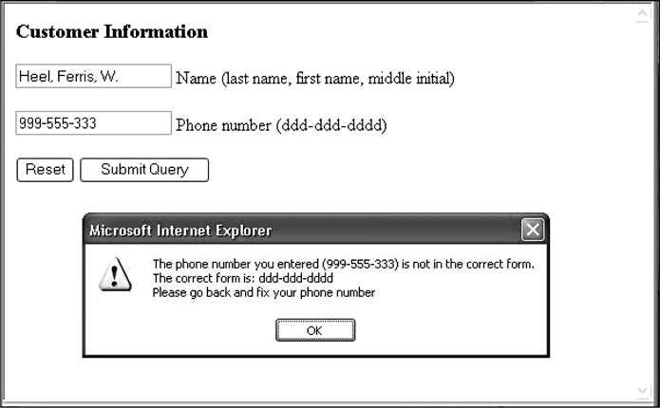
Figure 5.8 The message created by entering an invalid telephone number in validator.html

Slide 13
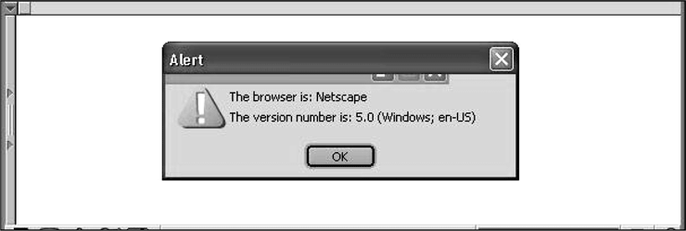
Figure 5.9 The navigator properties appName and appVersion for Firefox 2

Slide 14
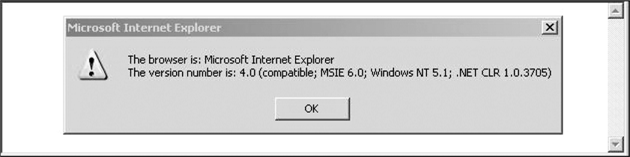
Figure 5.10 The navigator properties appName and appVersion for Internet
Explorer 7

